Slide 1


STOCK EXCHANGE
Presented by-
ROHAN ANAND
RUCHITHA CHEEKALA
RUCHITHA NUKALA
SAHITHI DAMERA

Slide 2


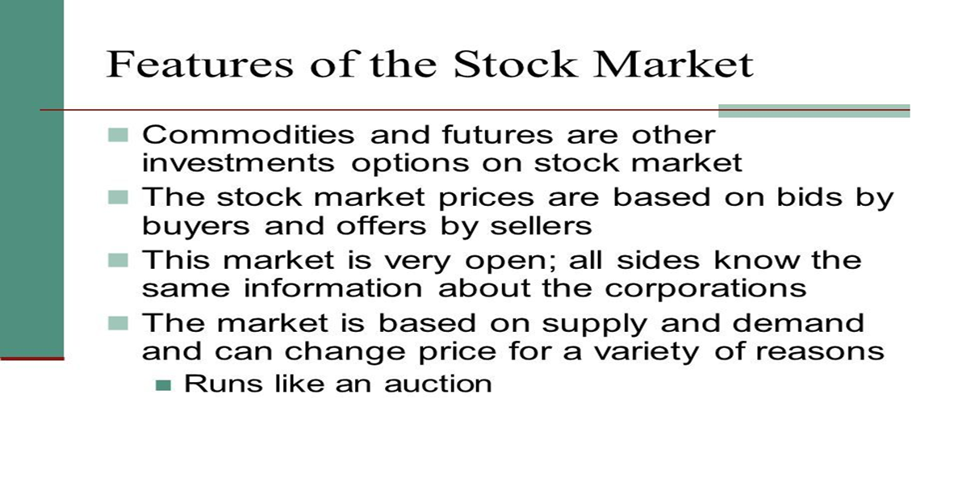
INTRODUCTION

Slide 3






Technologies used:
FRONTEND | BACKEND
HTML CSS JAVASCRIPT BOOTSTRAP | DATABASE MYSQL WORK BENCH
TEXT EDITOR | ECLIPSE EE JAVA
ECLIPSE EE | SERVLET
JAVA SERVLET PAGES | BROWSER MICROSOFT EDGE

Slide 4
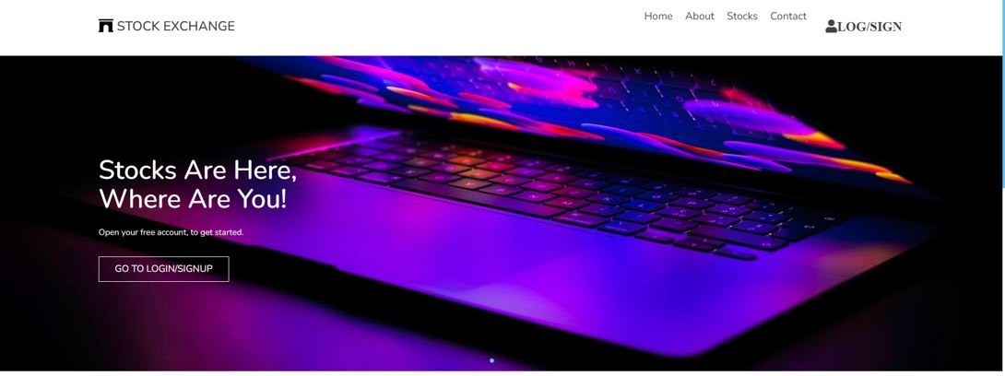
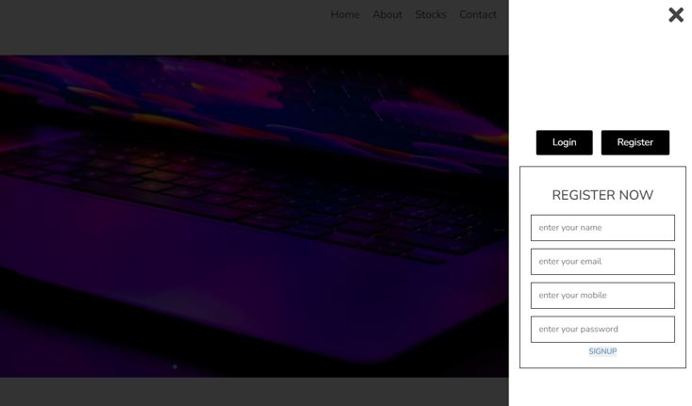
home page Register page

Slide 5
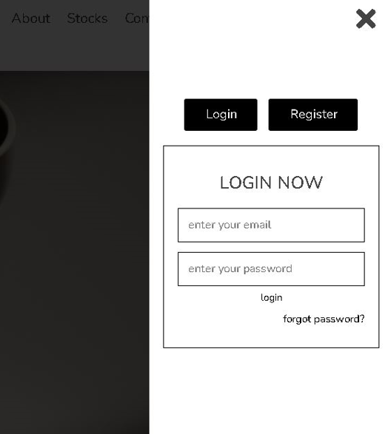
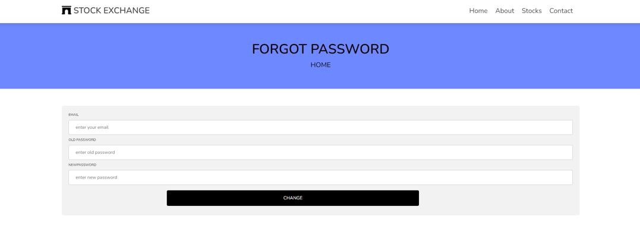
login page Password page

Slide 6
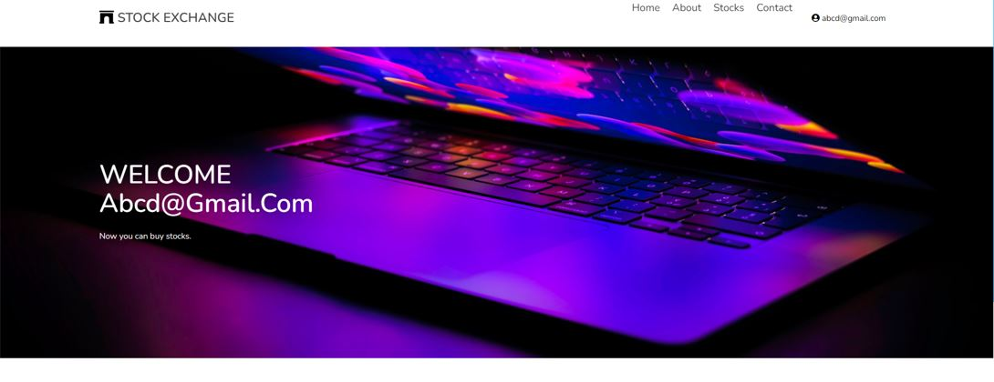
Users login page

Slide 7
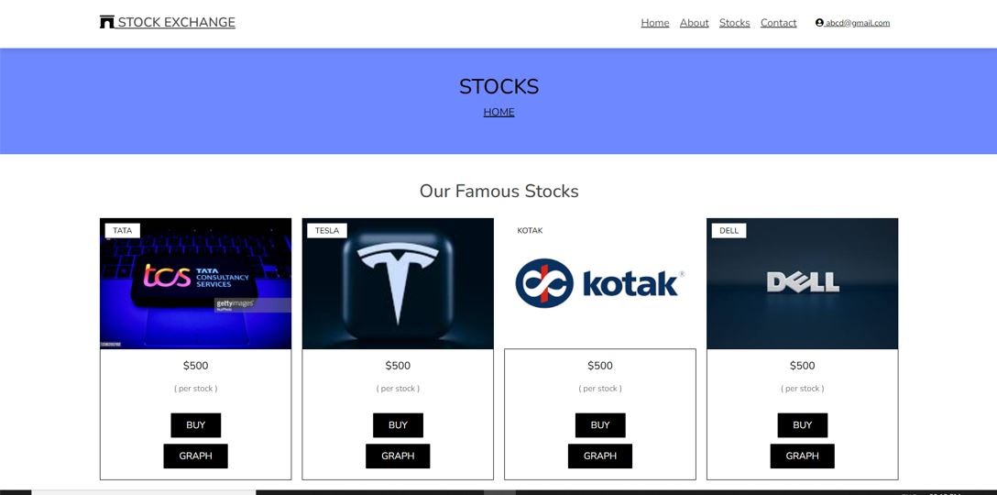
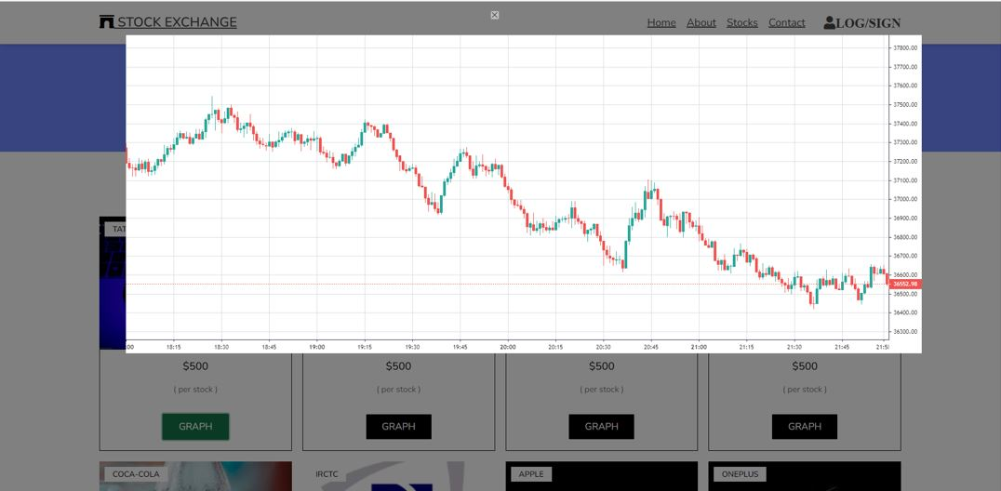
Stocks page

Slide 8
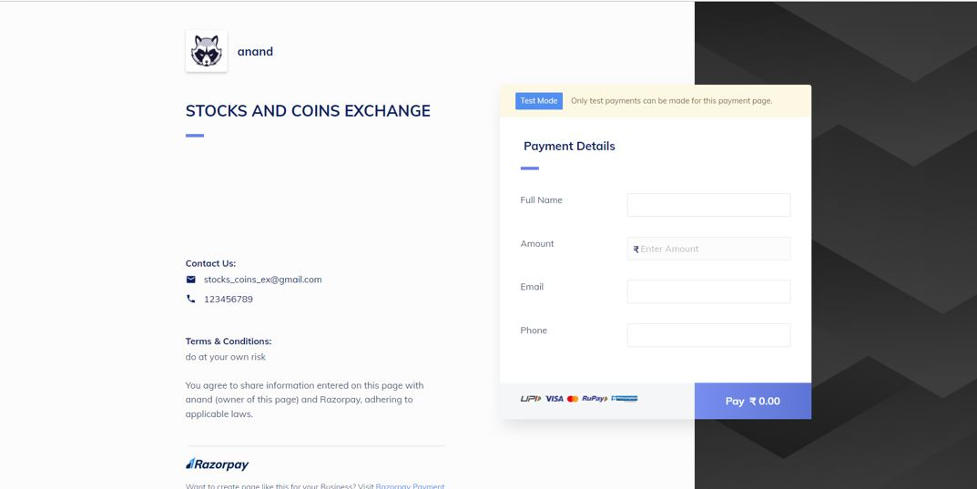
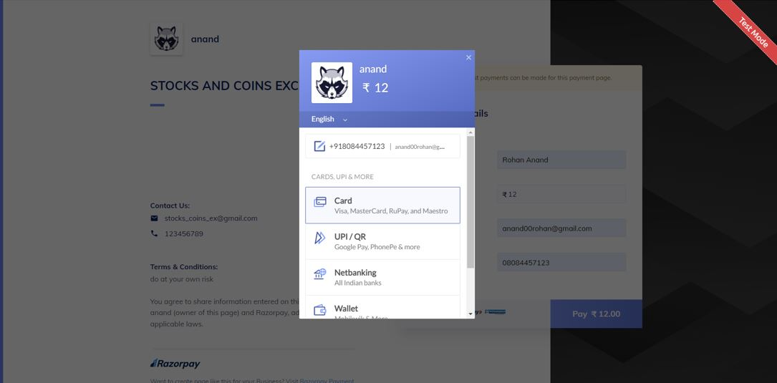
Transaction page:

Slide 9
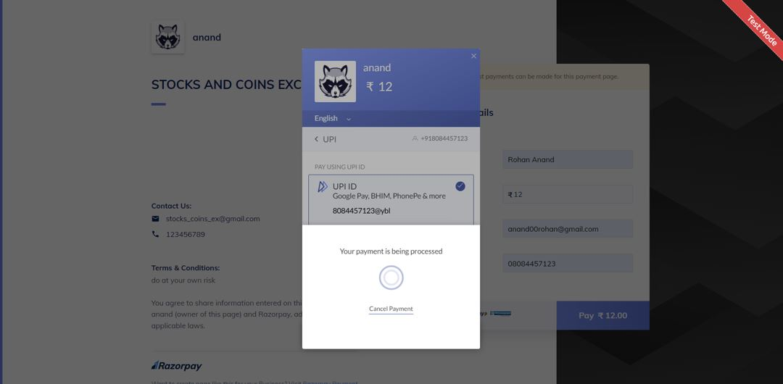
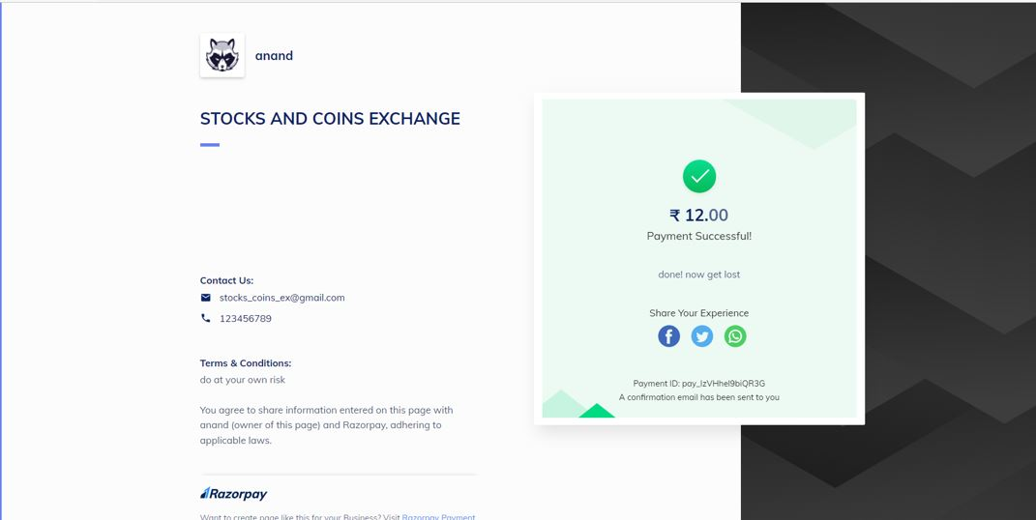

Slide 10
THANK YOU

